Slide 1
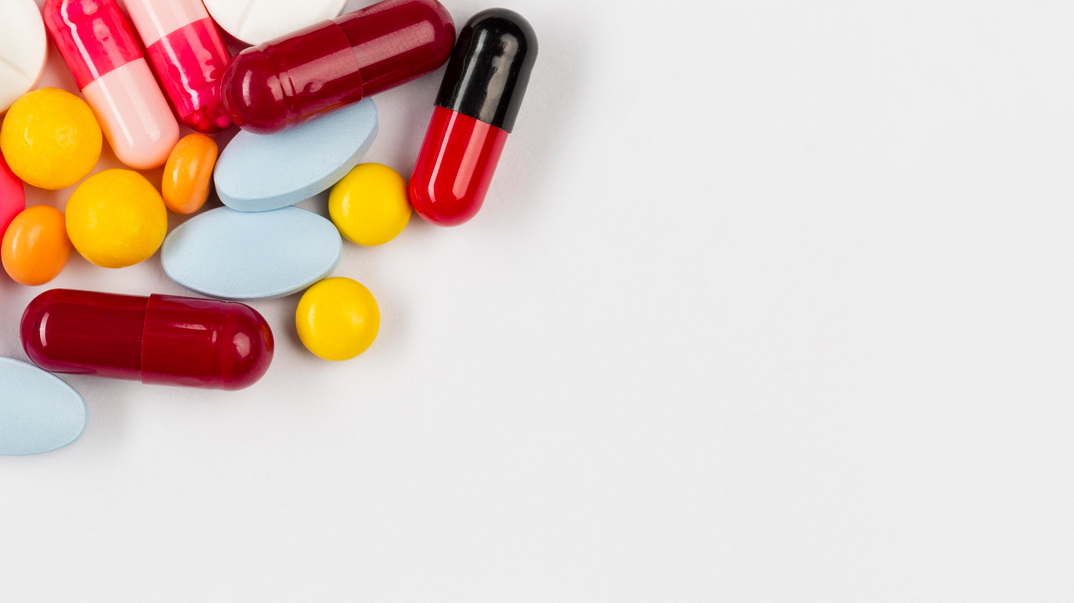
THE APP FOR PILL IDENTIFICATION
IDENT
Dr
A PROJECT BY JULIA NUSS
11/2024

Slide 2
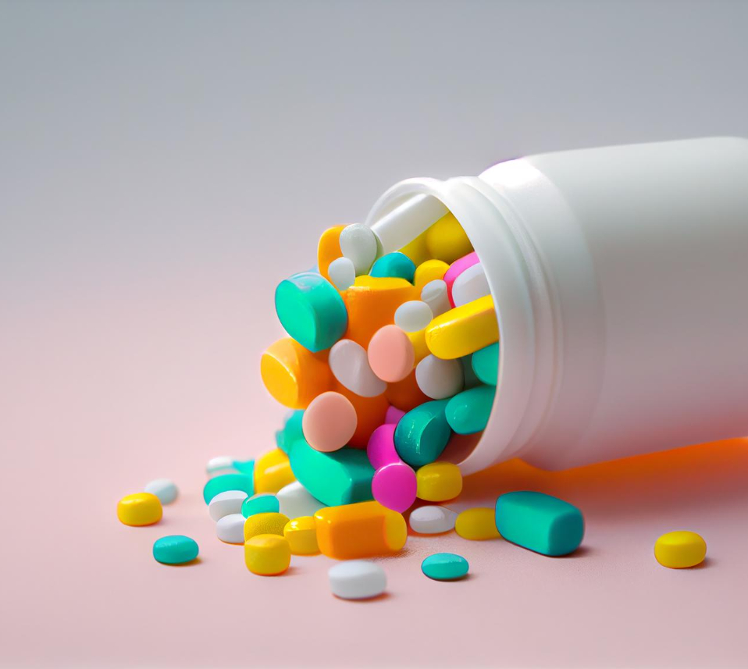
PROJECT OVERVIEW
THE GOAL:
Training a model for identification of solid pharmaceuticals
Deploying the model as a Web-App that faciliates an upload of different pill images for their identification
USE CASES:
Hospitals, old people‘s homes and bigger pharmacies that do blistering can use the app to optimize their workflow and avoid medication errors
Old people themselves can use the app to avoid confusions or being unaware of what the take if having to take multiple pills per day

Slide 3
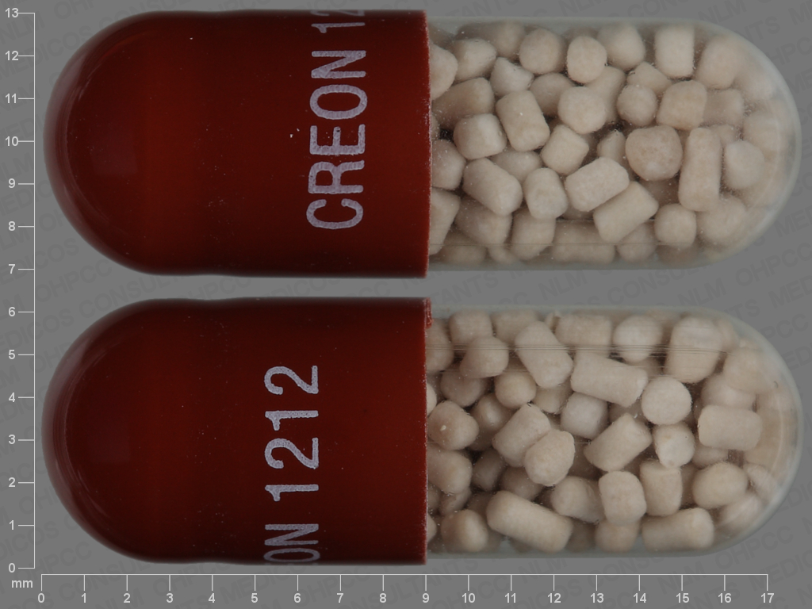
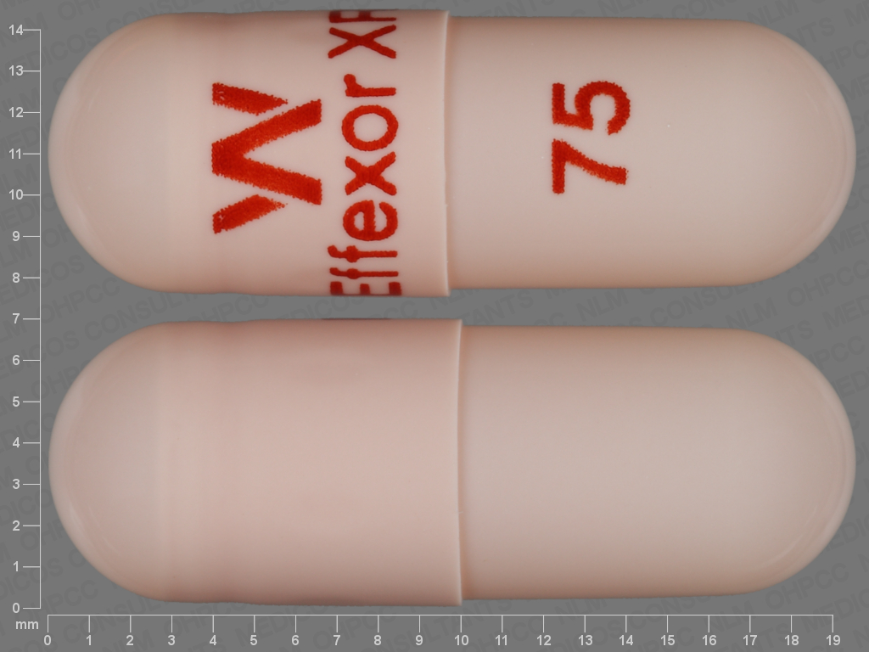
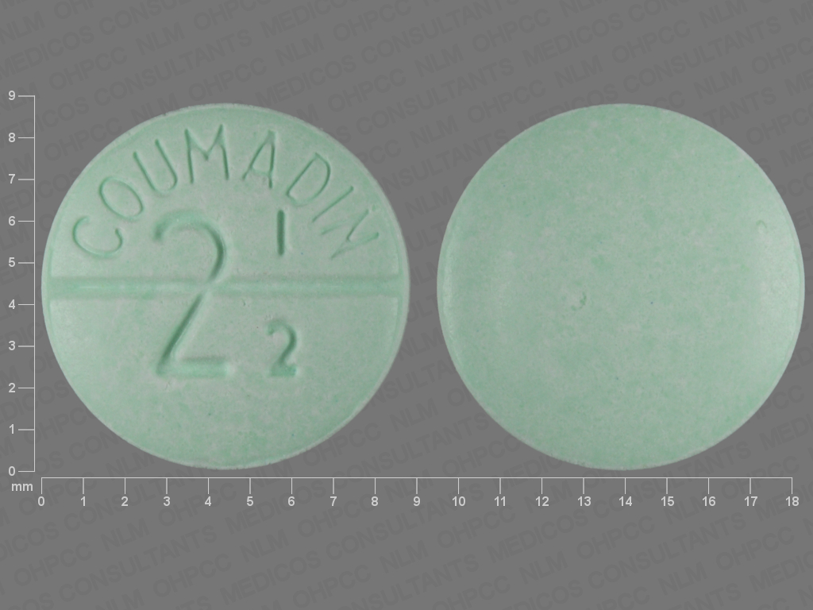
THE DATASET
Sources:
https://datadiscovery.nlm.nih.gov/Drugs-and-Chemicals/Computational-Photography-Project-for-Pill-Identif/5jdf-gdqh/about_data (provided by the National Library of Medicine)
https://www.kaggle.com/datasets/gauravduttakiit/pharmaceutical-drug-recognition (provided by Gaurav Dutta on Kaggle)
➞ concatenated the two datasets, then took a sample subset (50%) because the dataset was far too large and the kernel always crashed
➞ Problem No. 2: The dataset was very imbalanced, with some classes having significantly fewer samples which can prevent the model from learning properly and cause it to focus on the most frequent classes
➞ Solution: Used class weights to inform the model of the imbalance, giving less common classes a higher weight during training

Slide 4
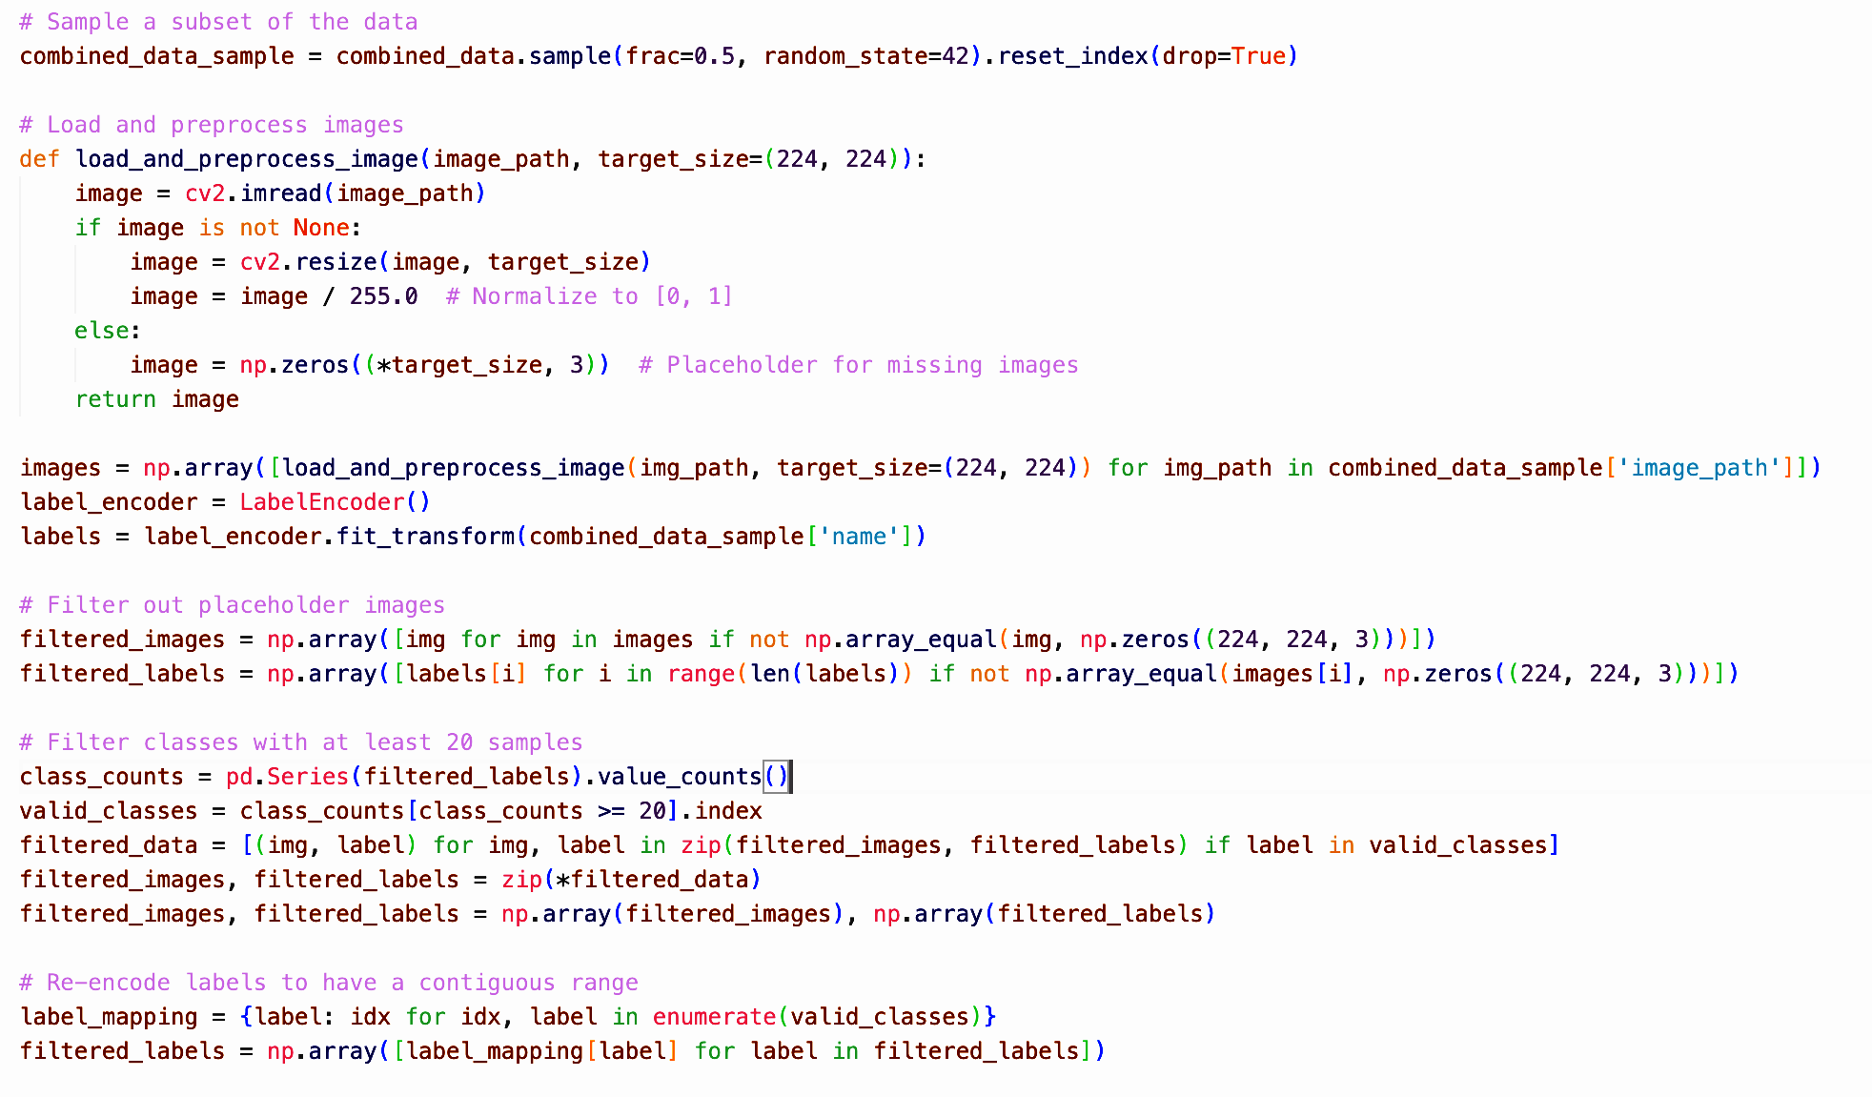

IMPLEMENTATION DETAILS
Sampling 50 %
of the dataset
Loading &
Preprocessing:
Resizing
Normalizing
Encoding labels
Filtering
placeholder
images
Filtering classes with few images
Re-encoding

Slide 5
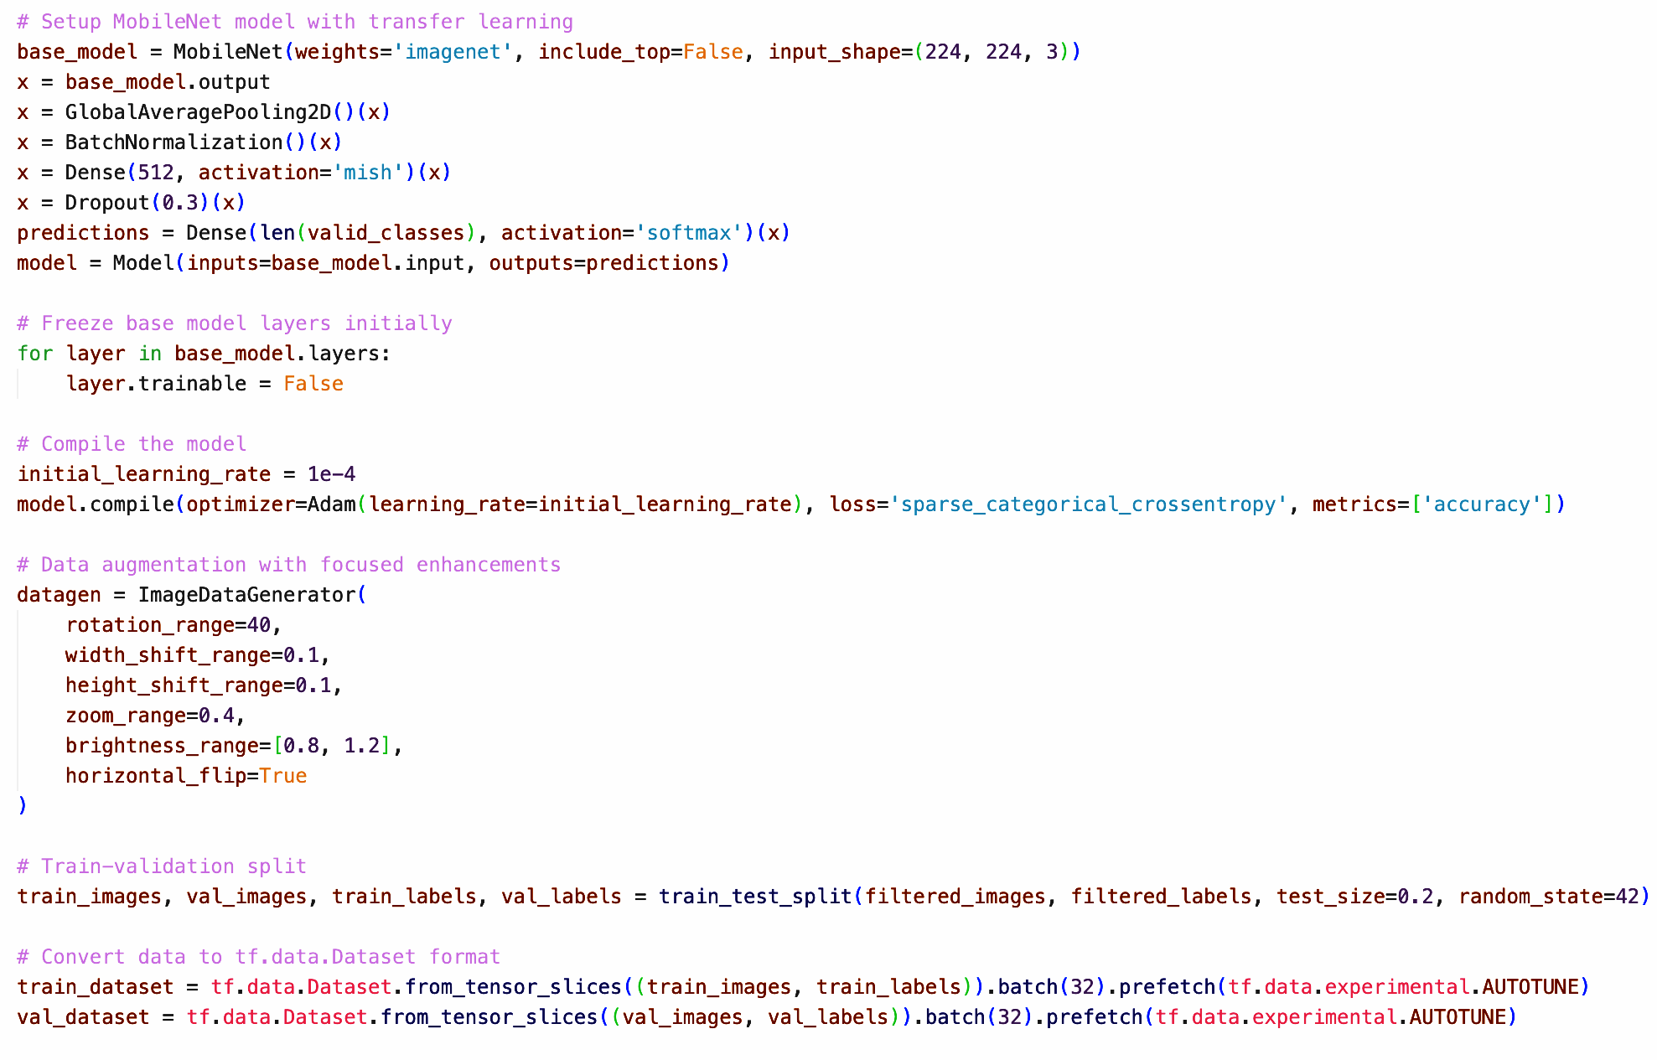
IMPLEMENTATION DETAILS
Transfer Learning
with MobileNet as
Base model
Initially freezing
Layers of pre-trained
model (focus on
newly added layers)
Compiling the model
Data augmentation
Splitting into train and validation images

Slide 6
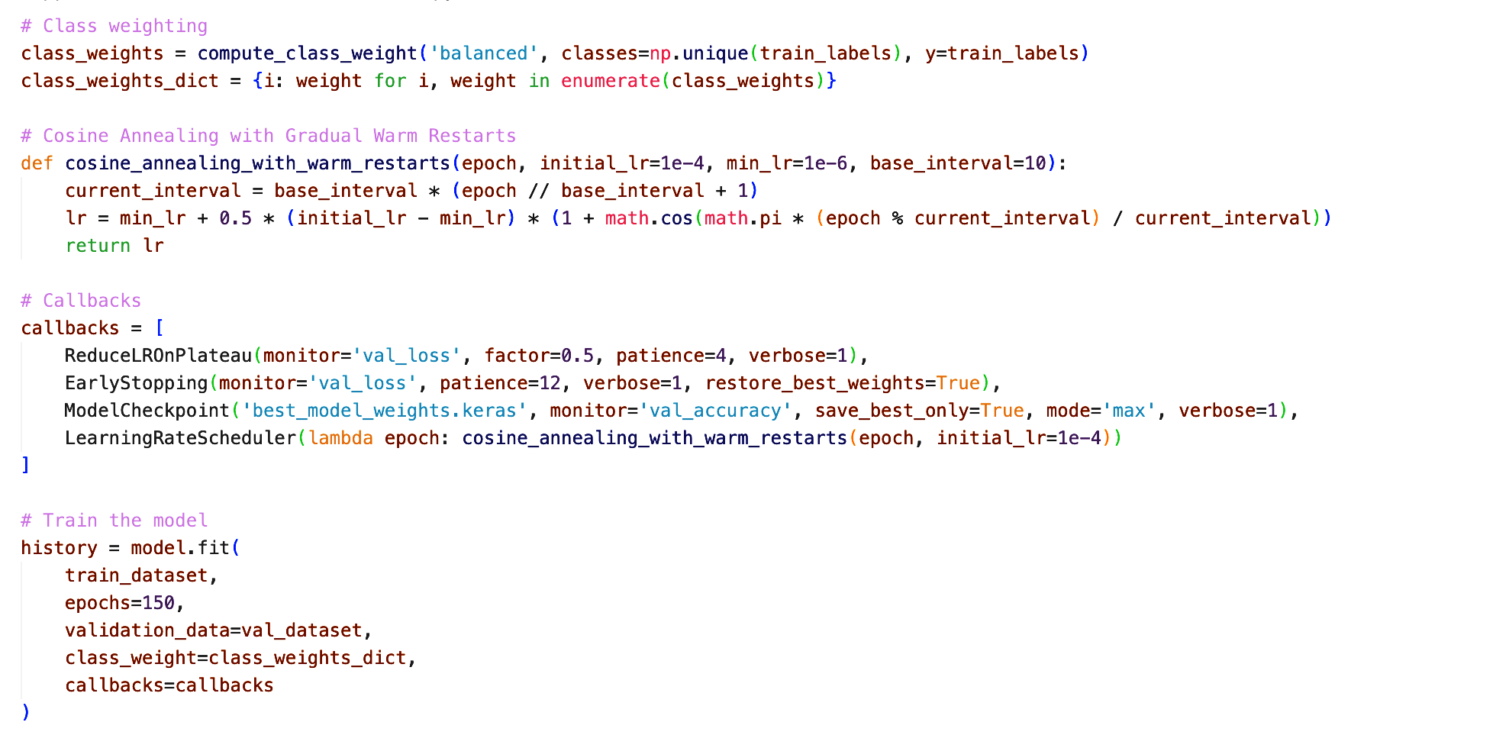
IMPLEMENTATION DETAILS
Class weighting: more importance to underrepresented classes
Cosine Annealing:
reduceing the learning rate following a cosine curve
Callbacks:
Reduce LR on plateau
Early Stopping
Saving best weights
LR scheduler
Initial model training with 150 epochs

Slide 7
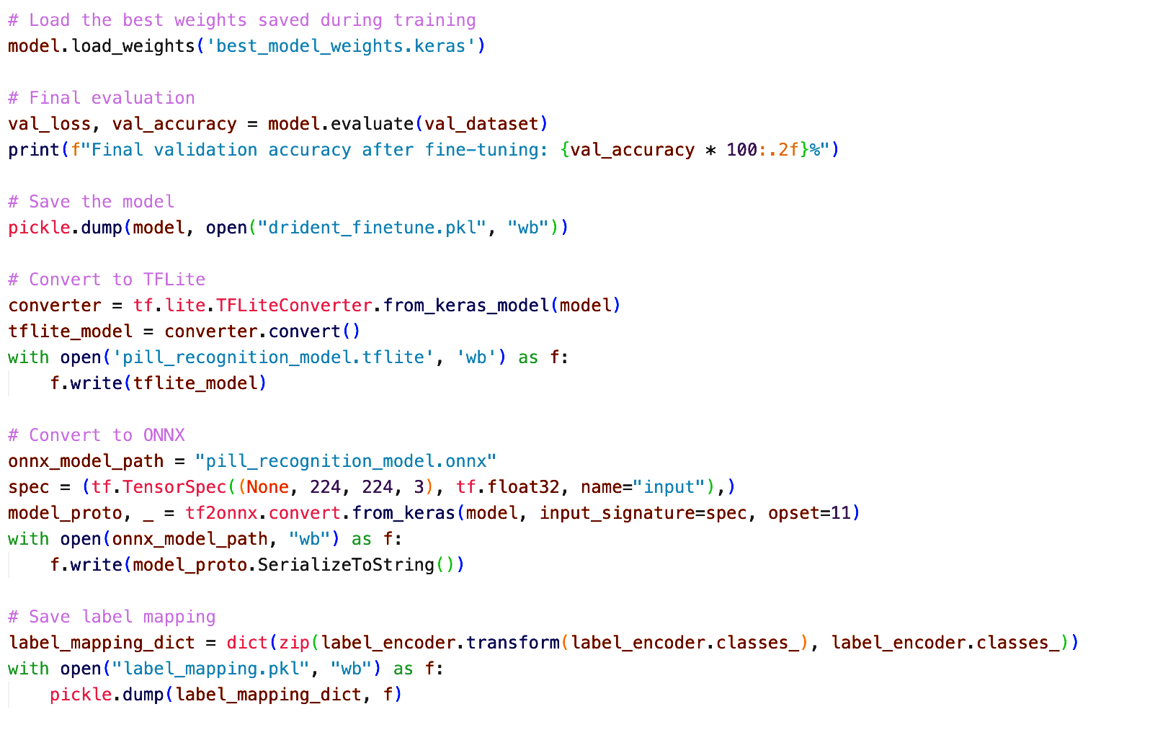
IMPLEMENTATION DETAILS
Saving the best
weights
Evaluation
Saving the model as .pkl
File conversions
Label mapping

Slide 8
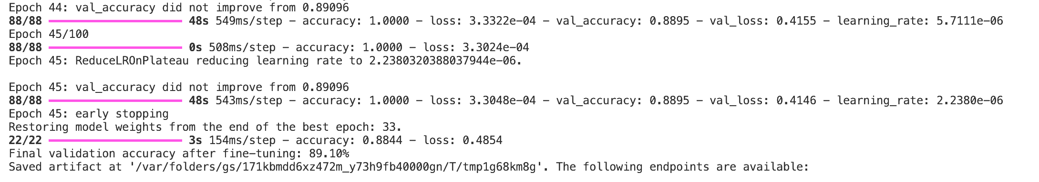
EVALUATION
Results of recent studies:
83.10% - 98.7%: Ashraf, A. R., Somogyi-Végh, A., Merczel, S., Gyimesi, N., & Fittler, A. (2024). Leveraging code-free deep learning for pill recognition in clinical settings: A multicenter, real-world study of performance across multiple platforms. Artificial Intelligence in Medicine, 150, 102844. https://doi.org/10.1016/j.artmed.2024.102844
90.8%: Al-Hussaeni, K., Karamitsos, I., Adewumi, E., & Amawi, R. M. (2023). CNN-Based Pill Image Recognition for Retrieval Systems. Applied Sciences, 13(8), 5050. https://doi.org/10.3390/app13085050
74.46% - 85,65%: Heo, J., Kang, Y., Lee, S., Jeong, D. H., & Kim, K. M. (2023). An Accurate Deep Learning-Based System for Automatic Pill Identification: Model Development and Validation. Journal of medical Internet research, 25, e41043. https://doi.org/10.2196/41043
82.5%: Kwon, H.-J., Kim, H.-G., & Lee, S.-H. (2021). Pill Detection Model for Medicine Inspection Based on Deep Learning. Chemosensors, 10(1), 4. https://doi.org/10.3390/chemosensors10010004

Slide 9
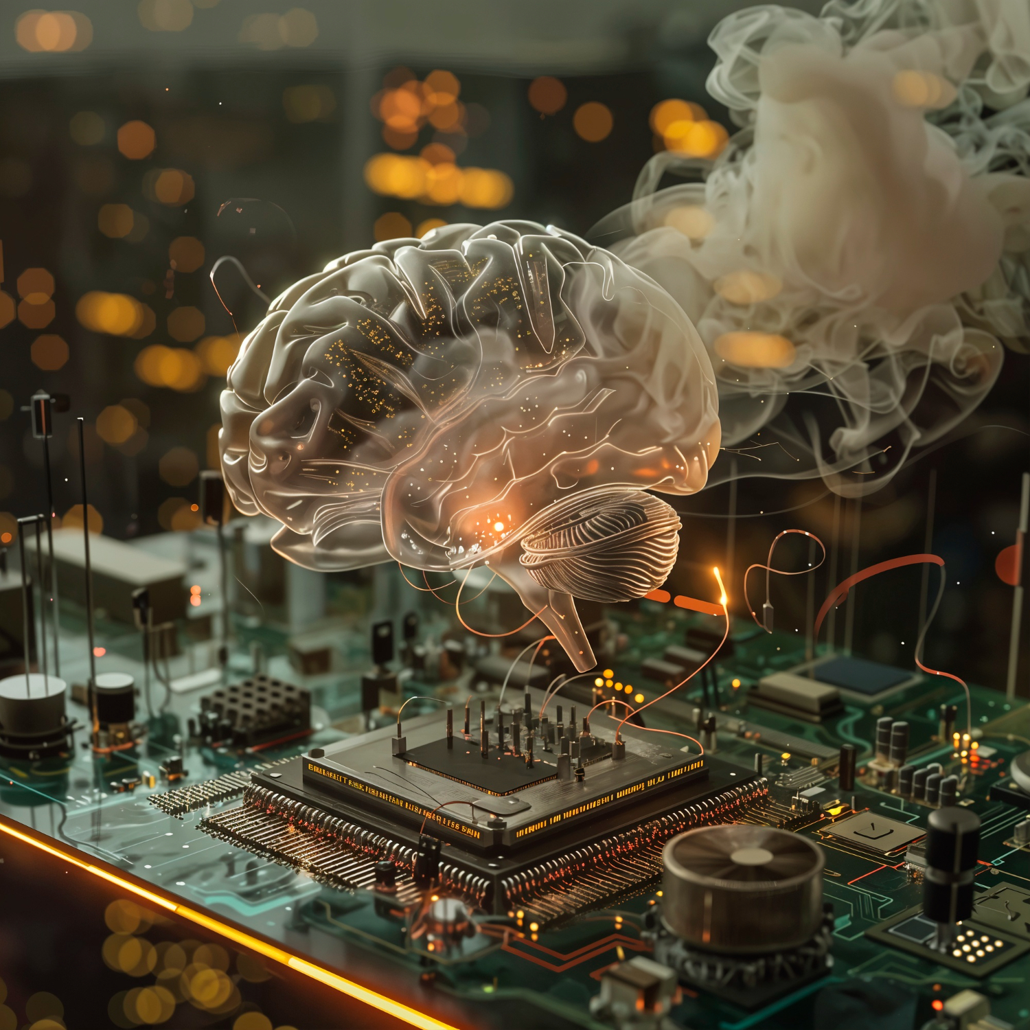
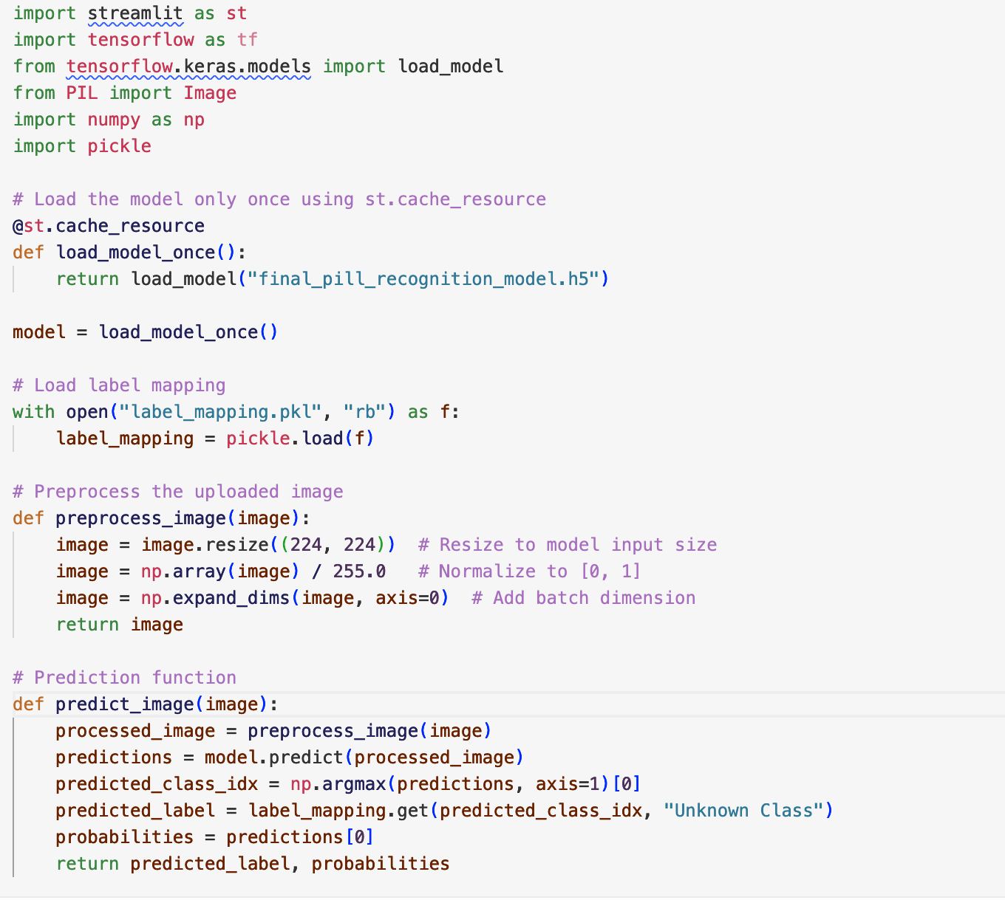
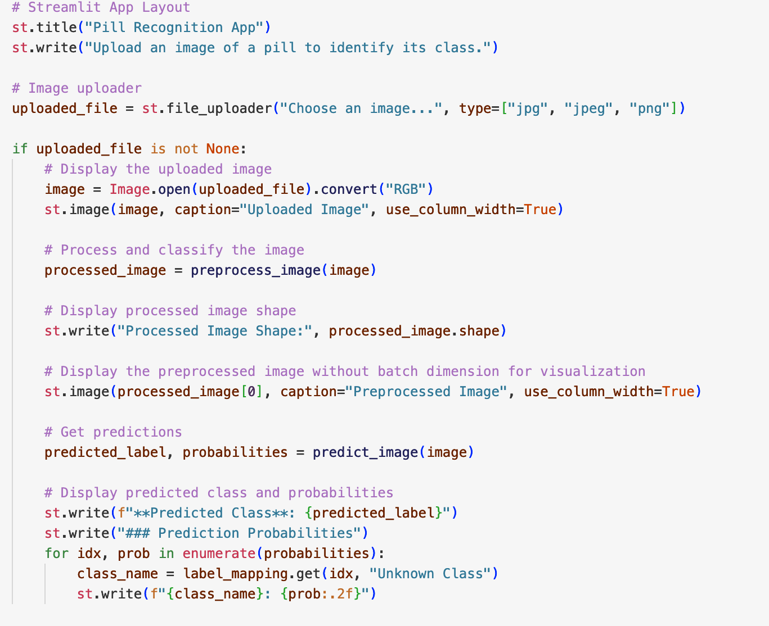
MODEL DEPLOYMENT
Using Streamlit to deploy the model as local browser app

Slide 10
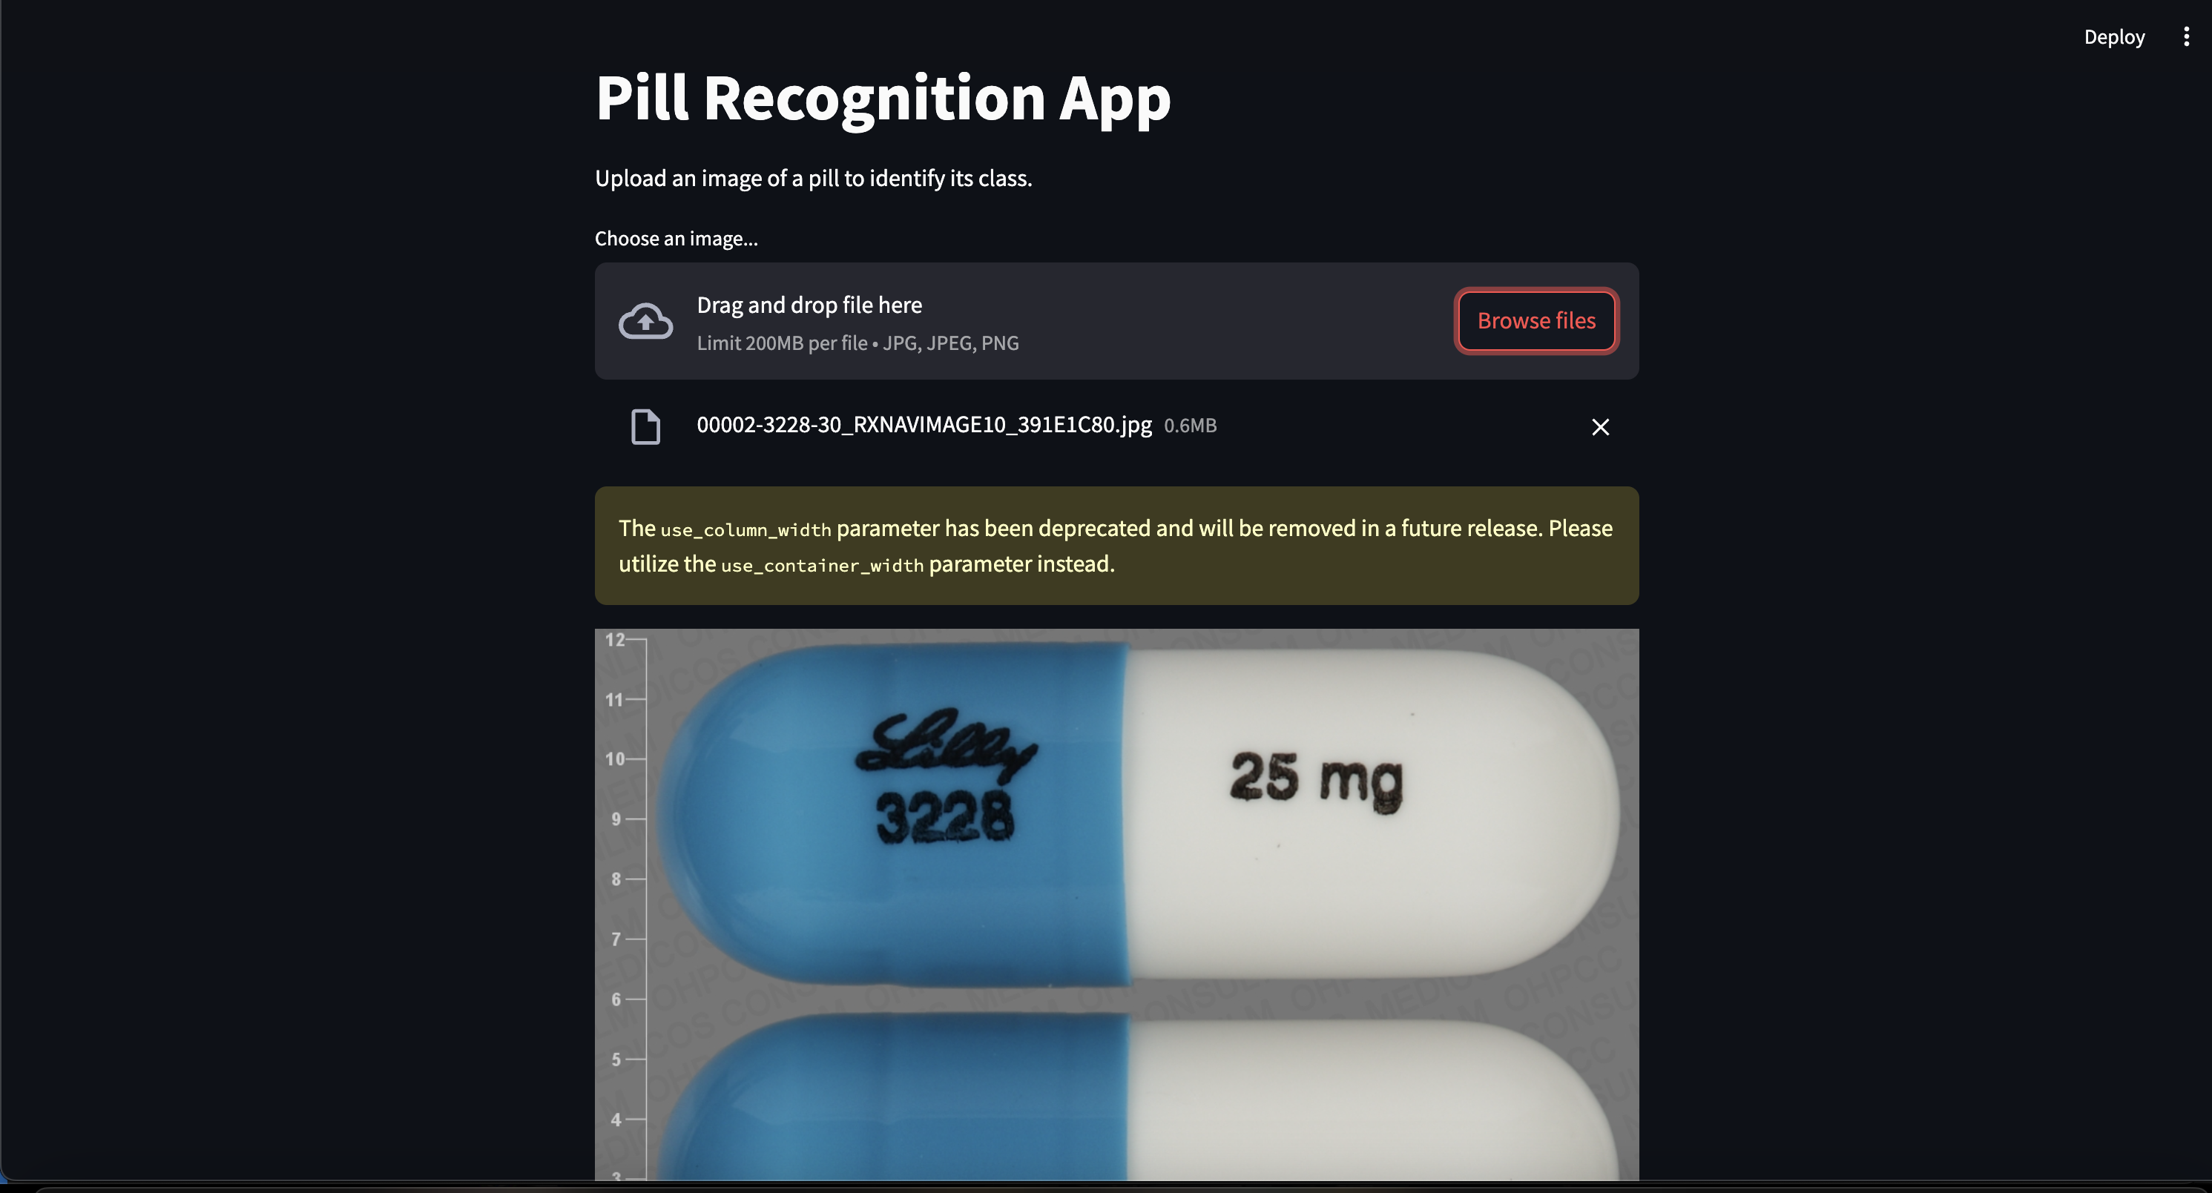

Slide 11
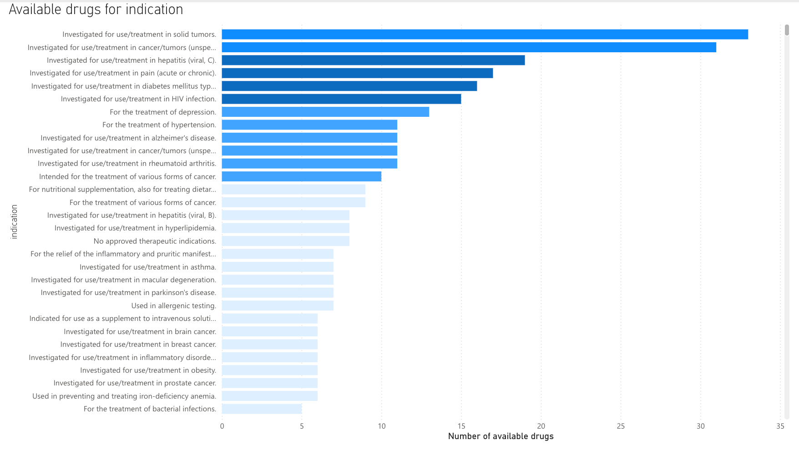

Slide 12
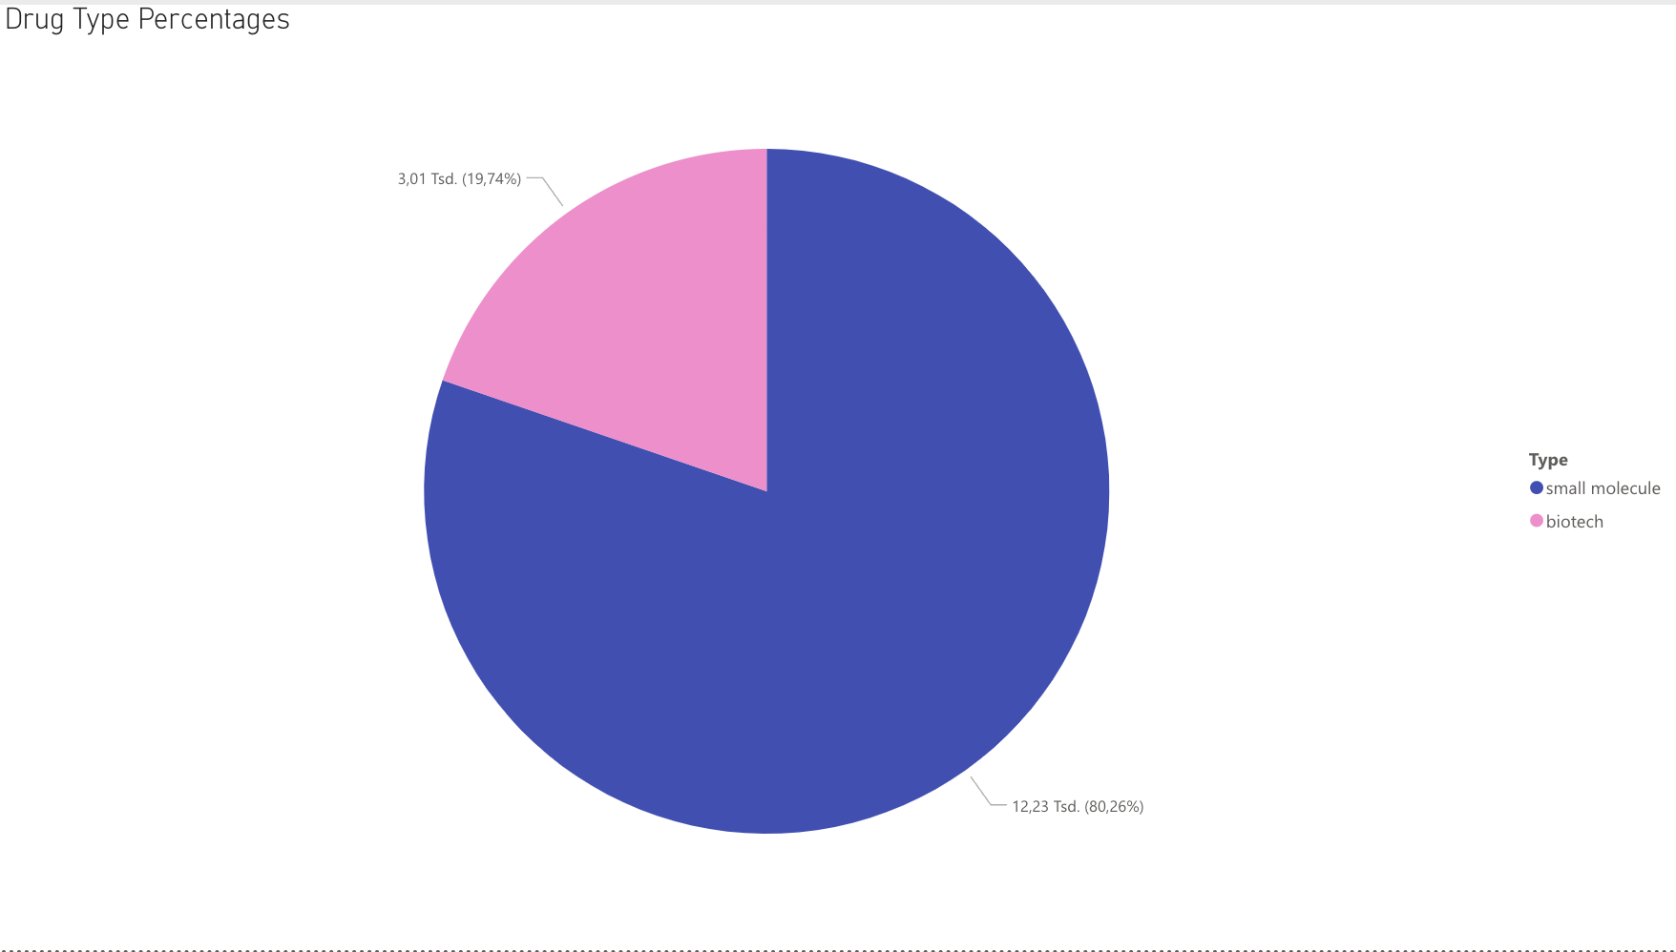
(Dataset from over one year ago,
Source from Debarghya Datta on Kaggle)

Slide 13

CHALLENGES & OBSTACLES
Large dataset: Kernel would crash when loading the whole concatenated dataset
➞ Solution: trained the model on a sample subset of 50% of the images
Imbalanced dataset: some classes had significantly fewer samples which can prevent the model from learning properly and cause it to focus on the most frequent classes.
➞ Solution: only used the classes of images that had more than 20 images and used class weights to give less common classes a higher weight during training
The initial idea was to deploy the model as an AR app using Unity
For that the text showing in case of detection has to be mapped with the results (worked)
Packages for importing a model into Unity and deploying an app that can use the model for image detection via camera:
Barracuda (deprecated) ➞ now Sentis ➞ require .onnx-file, must be attached to empty GameObject linked to C#-script calling the model
Linking worked but methods weren‘t recognized

Slide 14
CHALLENGES & OBSTACLES
TensorFlow lite: scoped registry (can‘t be directly imported as package but has to be cloned on GitHub using Git LFS for large files)
Had to adapt Packages/manifest.json file and manually set an URL in scoped package registry
Restrictions when trying to use OpenUPM CLI: needs access to the internet, proxy variable setting didn‘t allow
➞ Solution: set new proxy variables
Tflite model had to be imported as a TextAsset and as well attached to C#-script and GameObject ➞ Unity didn‘t recognize model (Error in loop „Interpreter not initialized“)
Unity-ML Agent: working with .onnx-files,
create ML AgentEnvironment with attached Script and model ➞ model couldn‘t get attached
FINAL SOLUTION: Deploying the app as a web app regarding the lack of time

Slide 15




TOOLS & TECHNOLOGIES
Visual Studio Code
Code in Python & C#
Chat-GPT 4o
Debugging and coding
Unity Engine
On trial for model deployment
Using packages:
Sentis
Tensorflow Lite
ML Agent
Streamlit
Final model deployment

Slide 16
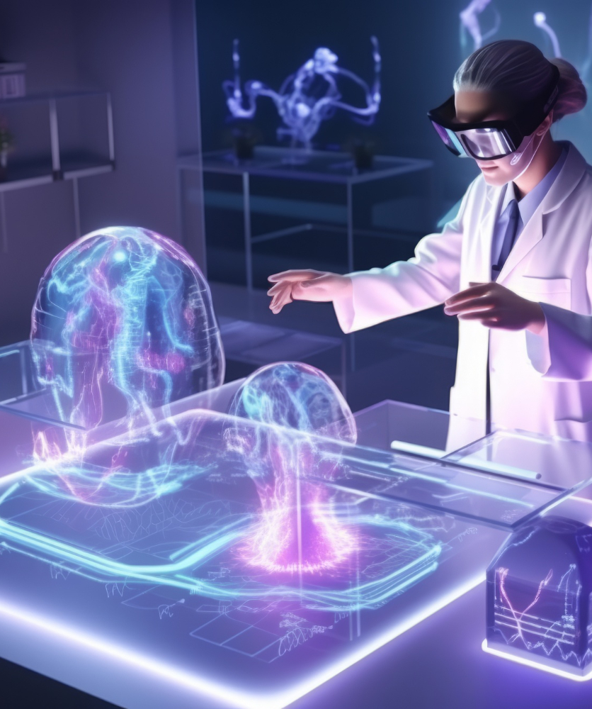
MAJOR OBSTACLE
The major obstacle in the project was that the model couldn‘t get to work properly in Unity, so the idea of an AR app could not be further pursued so far
➞ can be faciliated with more time and deeper knowledge in the future

Slide 17
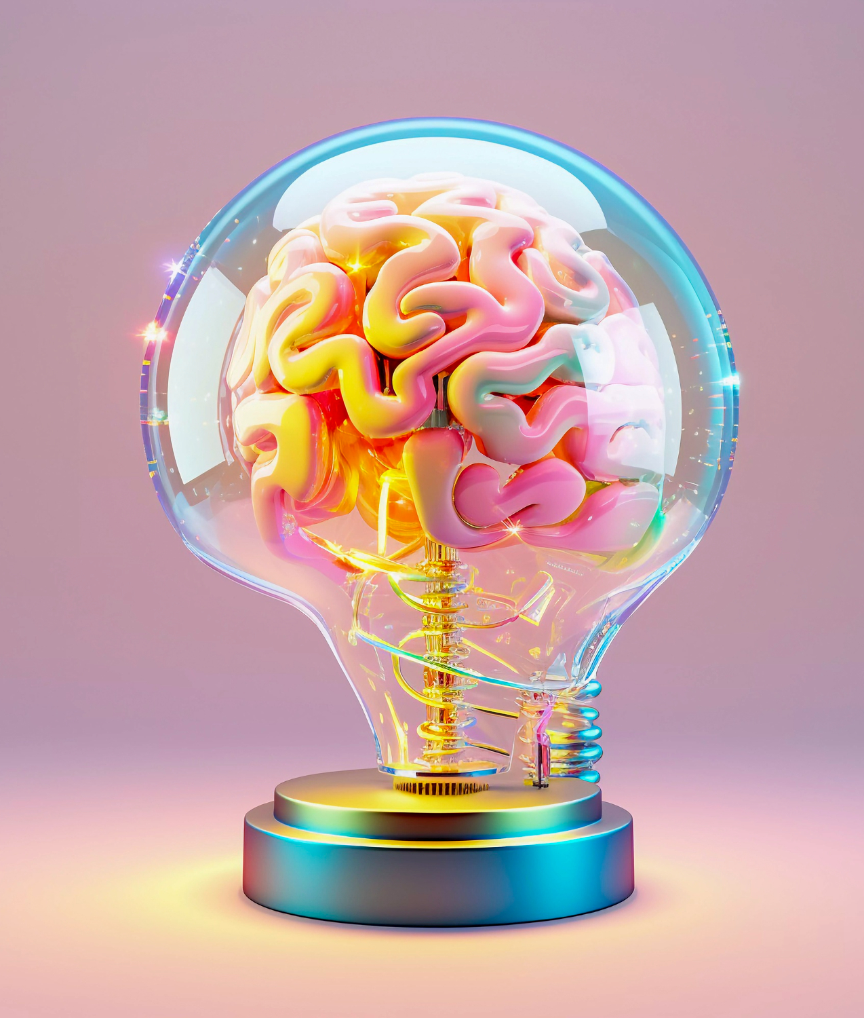
CONCLUSION & INSIGHTS
Through the project I learned how the model can be trained in a proper way despite having a very imbalanced dataset, I managed to increase accuracy from around 25% to 89.10% which is by now a common accuracy for pill detection models
(as expected) Transfer Learning works best for pill detection
Deploying the model by using Unity Engine brings a lot of challenges and could unfortunately not be managed so far, but I learned a lot about importing and scripting models in Unity through trying

Slide 18
THANK YOU FOR LISTENING!
JULIA NUSS
IDENT
Dr
THE APP FOR PILL IDENTIFICATION

